Slide 1
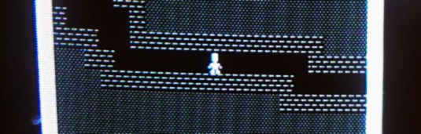

Multiplayer Roguelike Game for the Commodore 64
Leif Bloomquist World of Commodore 2017

Slide 2
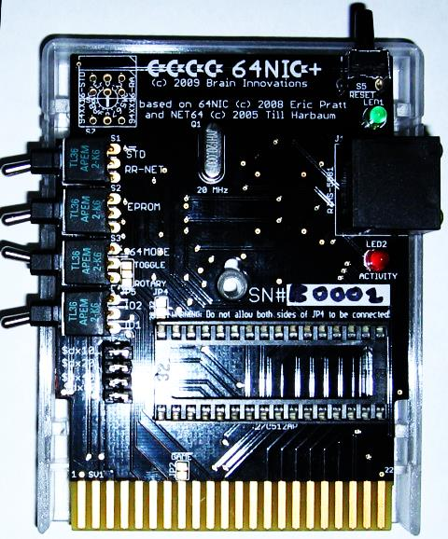
Background
Ethernet+TCP/IP networking solutions available for the Commodore 64 for over 10 years!
The Final Ethernet, RR-Net, FB-Net, 64NIC+, ETH64…
Plenty of tools – file transfer, terminals, chat, cross-development, web browsers, etc.
Where are the games?
(Fortunately, I like writing C64 games)

Slide 3
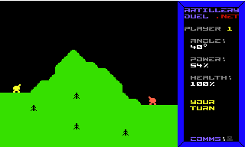
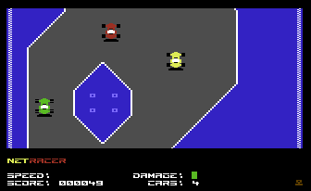
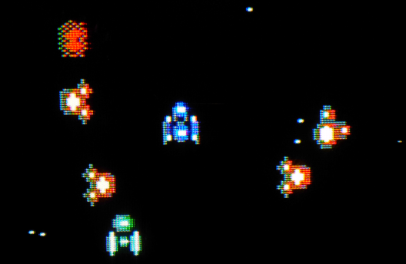

Evolution of C64 Multiplayer Games
NetRacer (2008)
Introduced a server
Static game world
Maximum 8 players
Real-time
Vortex 2 (2014)
Introduced server-controlled enemies
Dynamic game world (in work)
Massive game world (10,000 screens)
Unlimited players
Real-time
This game (2018)
Server-controlled enemies
Dynamic, interactive game world
Added third dimension (depth)
Object persistence
Unlimited players
Real-time
Artillery Duel Network (2007)
Two players
Peer-to-Peer
Turn-based
Source code for all of these is available on GitHub – use them as a basis for your own games!

Slide 4
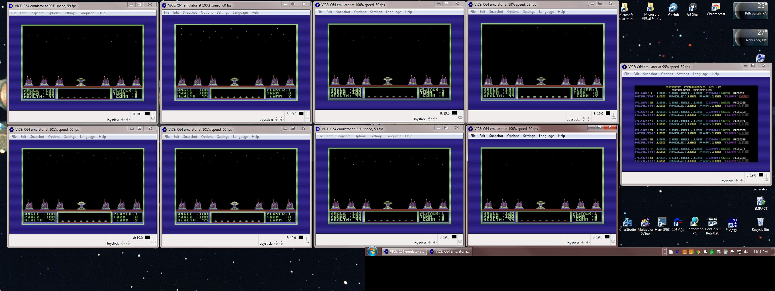
Evolution of C64 Multiplayer Games
Space Command by Dan “Ragooman” Ragonti and Jefferey “arkaxow” Brace
Eight-Player Simultaneous real-time “Artillery Duel”-type game, with C64+SuperCPU server!

Slide 5
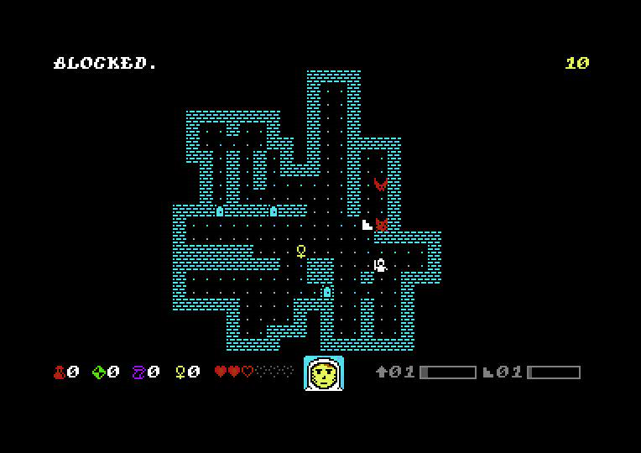
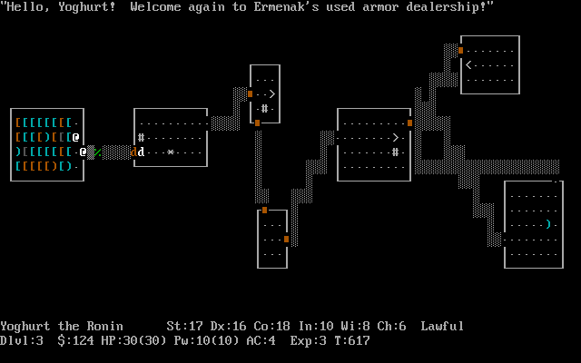
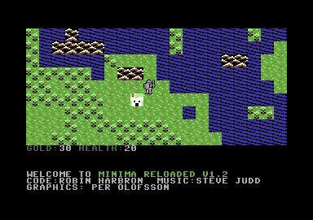
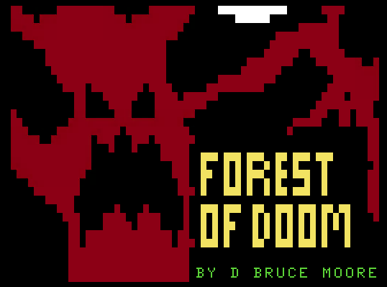
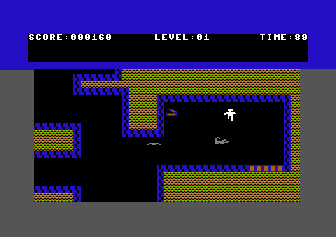
Inspiration
Demons of Dex (VIC20/C64)
NetHack (Unix/DOS)
Forest of Doom (Coco)
Gateway to Apshai (C64)
Minima (C64)

Slide 6
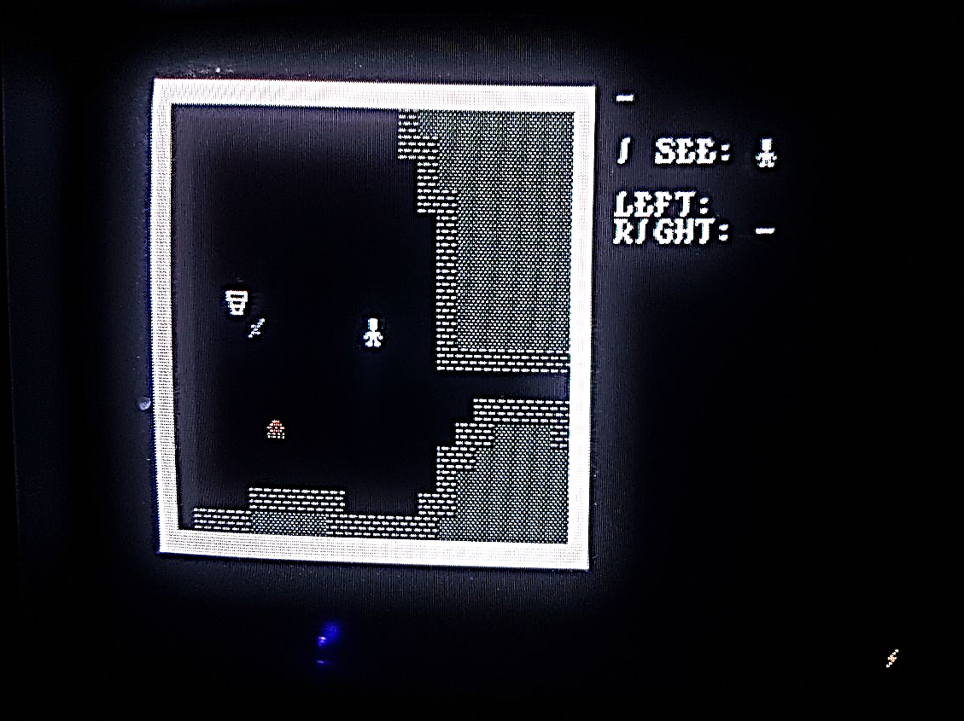
“The Game With No Name” (yet!)
“Roguelikes” aka “Dungeon Crawlers” are one of my favorite genres of games!
What if…the other characters in the dungeon were other players that you could…
Interact with?
Go on quests together?
Team up against monsters?
Work together to solve puzzles?
Leave each other tools, clues, share equipment?

Slide 7
Some deviations from the standard “RogueLike”
Real-time (not turn-based)
One single, shared instance
Multiplayer
Object persistence
Monster persistence (with respawn)
“Multi-User Dungeon”

Slide 8
Implementation Details
Server:
Written in Java 8
~80% code re-use from Vortex
C64 Client:
C64 client written in 6502 assembler (ca65)
IP65 network stack – RR-Net, 64NIC+
UDP with simple ACKs
Networking:
Screen streamed to clients on change, or 1 Hz

Slide 9
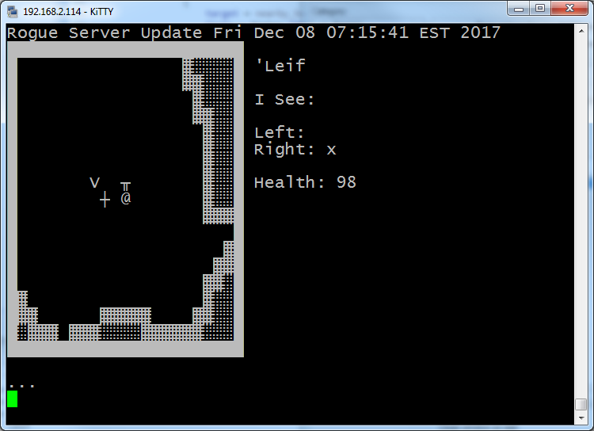
Multiple Clients!
Partially Implemented:
Commodore 64 (PETSCII color graphics, SID sound)
Telnet – Linux or PuTTY (ASCII/UTF-8, monochrome)
VT100/DEC Terminals (ANSI, monochrome)
(a bit buggy)
Future:
Tandy Coco? Retro Innovations CoCoNIC…
Apple II (ATASCII) - Uthernet II
VIC 20 (PETSCII color graphics, VIC-I sound)?
Atari?

Slide 10
A Peek Under the Hood

Slide 11
Model-View-Controller Architecture
Model
- Data structure with all maps, object, and entity locations
- Logic for what actions are allowed
View
Controller
Representation of immediate area
Entity Actions
(Players, Monsters )
Translations
(PETSCII, ASCII, ANSI, UTF-8, etc.)
Server
AI
Players
Socket
Interface
(TCP/UDP)

Slide 12
Entity Behaviour “AI”: Finite State Machine
Wandering
Idle
Chasing
Retreating
Attacking
Tweaking the state transition conditions gives the monsters different behaviours and “personalities”

Slide 13
Game Levels
Mix of hand-edited and procedurally generated
Initial target is 10 levels
Still many gameplay details to be worked out

Slide 14


Thank You!
Advice and motivation: Robin Harbron
Networking code: Per Olofsson, Jonno Downes
Playtesting: Andreas Bloomquist, Glenn Holmer, Tiffany Antopolski
Graphics: “q0w/Atlantis”
Music and SFX: “snabel”
Coco porting motivation: D. Bruce Moore
/r/roguelikedev community on Reddit

Slide 15
Demo!

